Slide 1


machine learning text analysis assignment

Slide 2
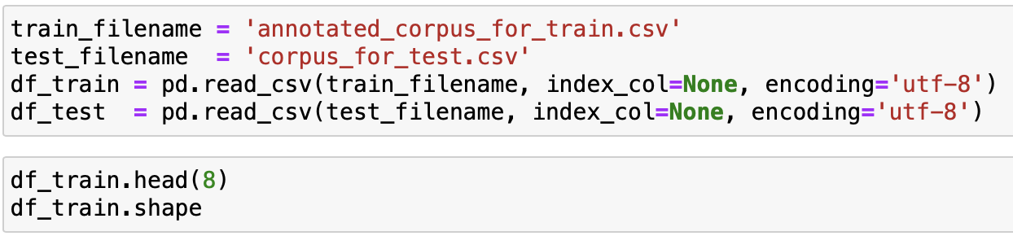

Reading input files

Slide 3
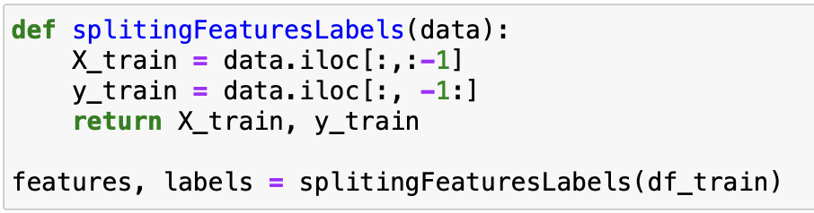

Splitting the data to features and labels

Slide 4
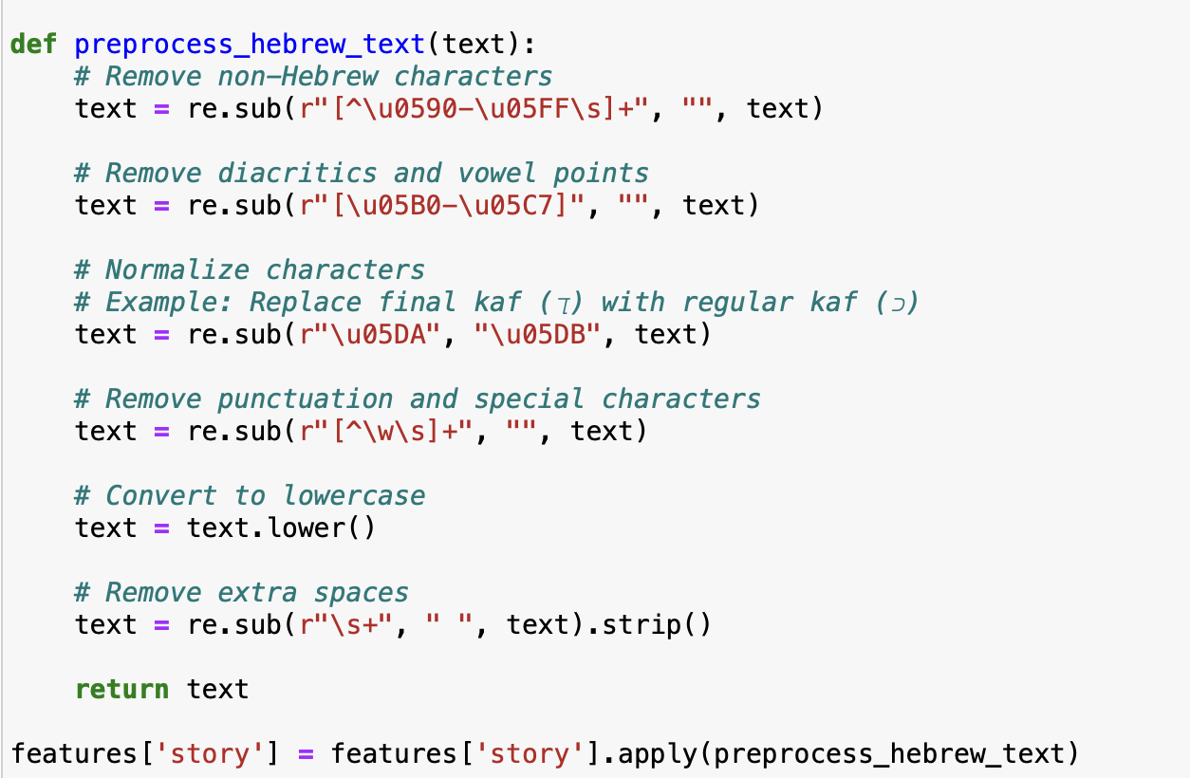

Preprocessing data

Slide 5
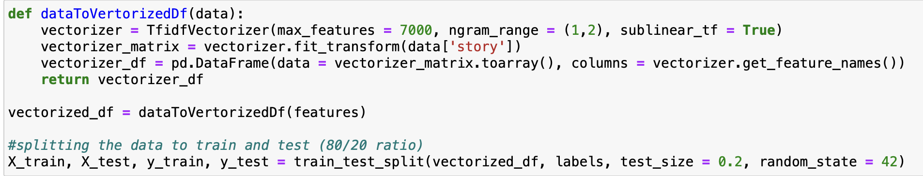
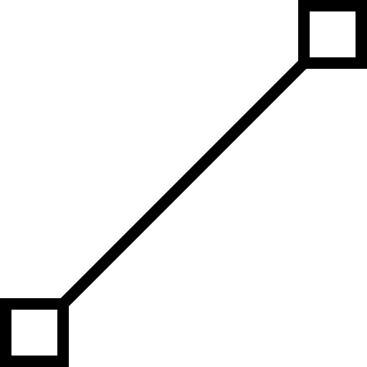
Vectorizing the data set

Slide 6
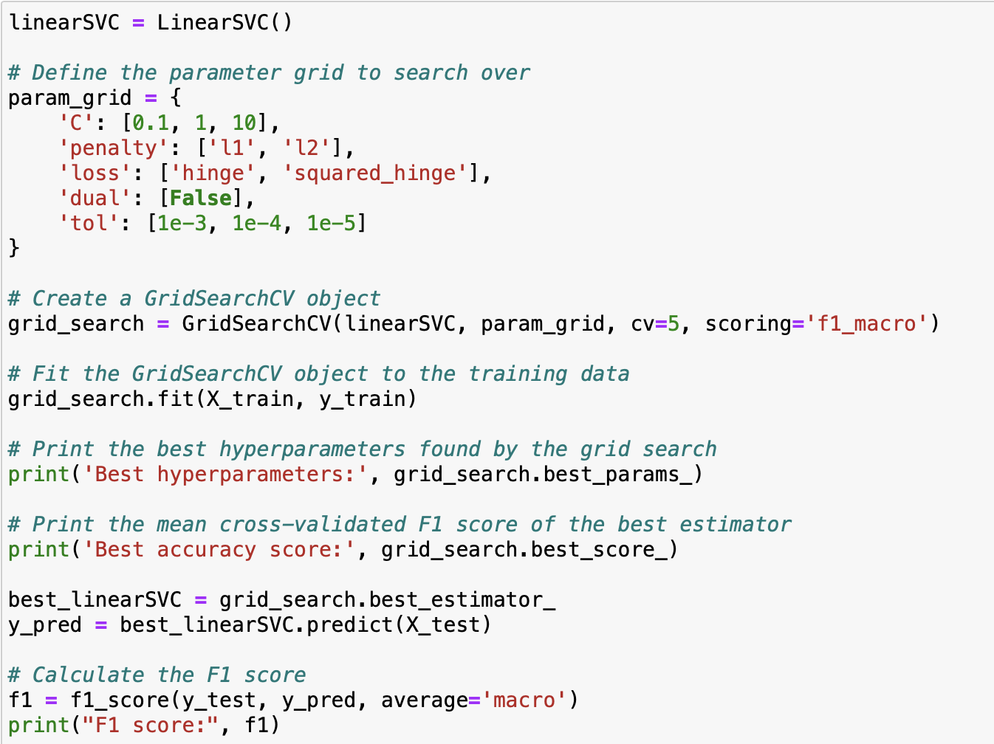
Linear SVC Model

Slide 7
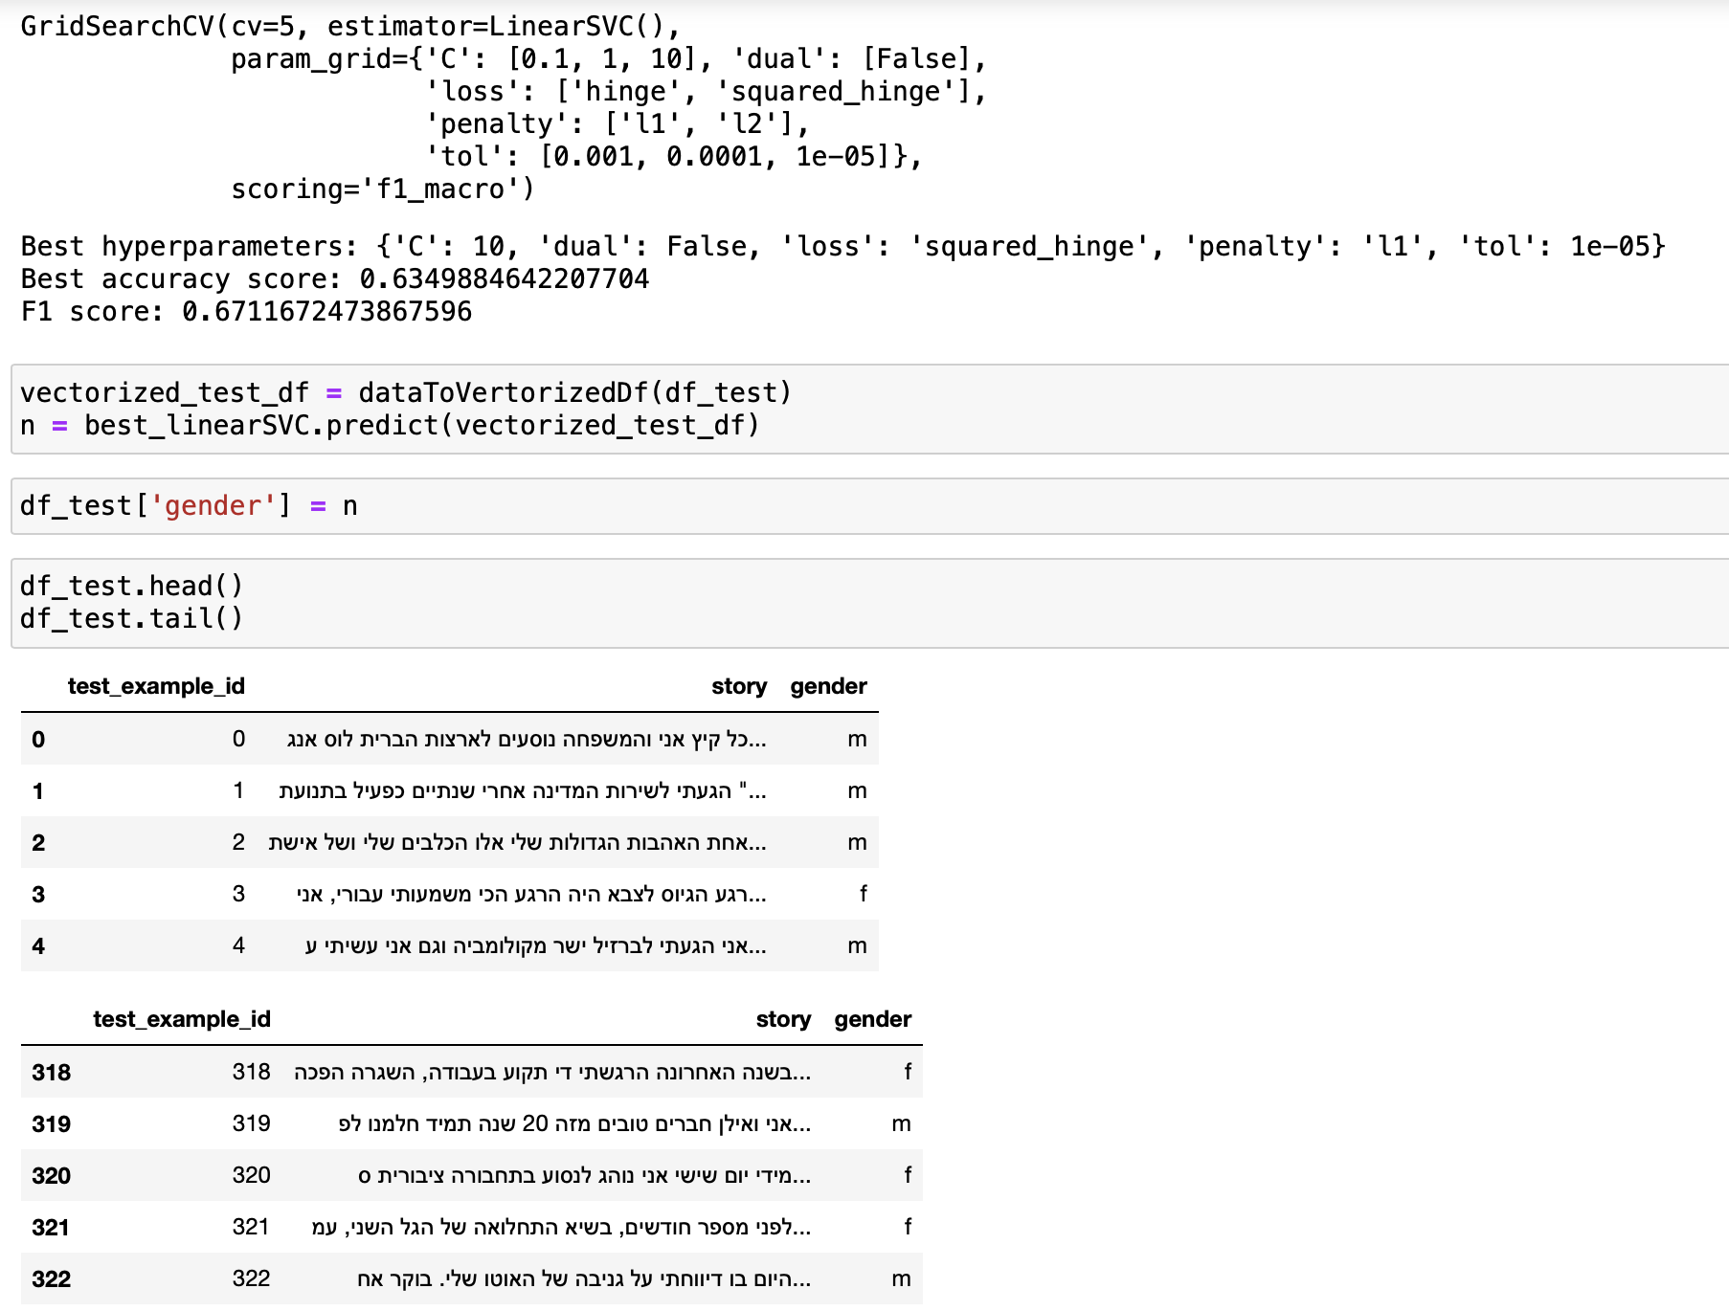


Results Linear SVC

Slide 8
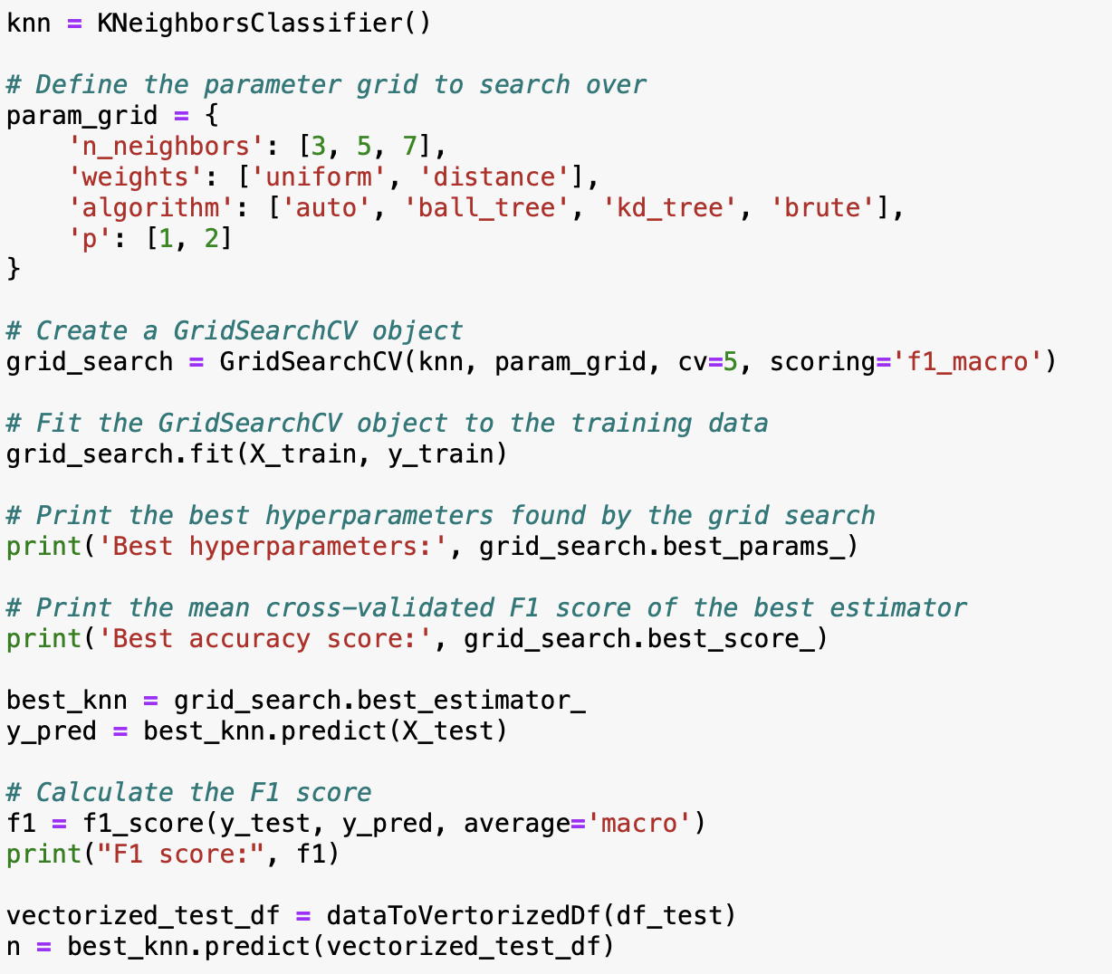
KNN Model

Slide 9
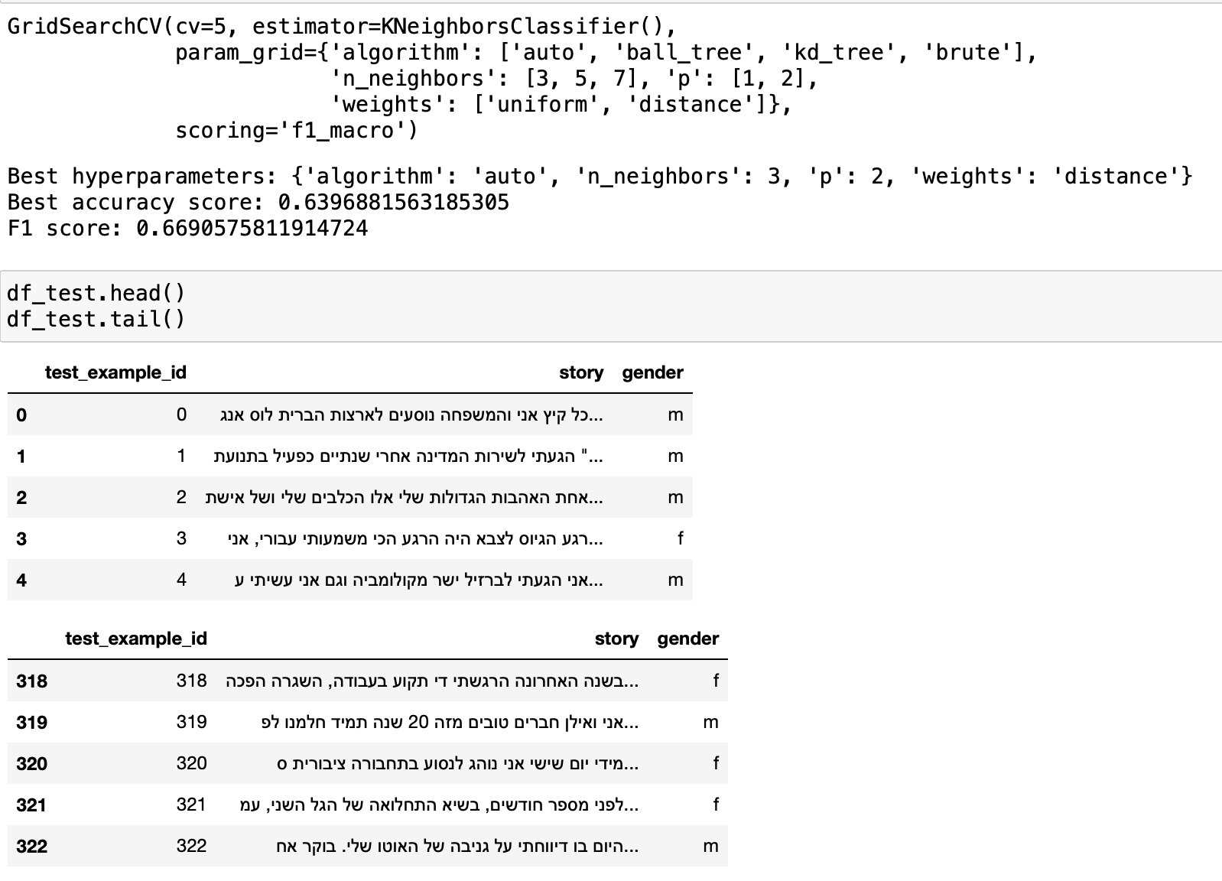
Results KNN

Slide 10
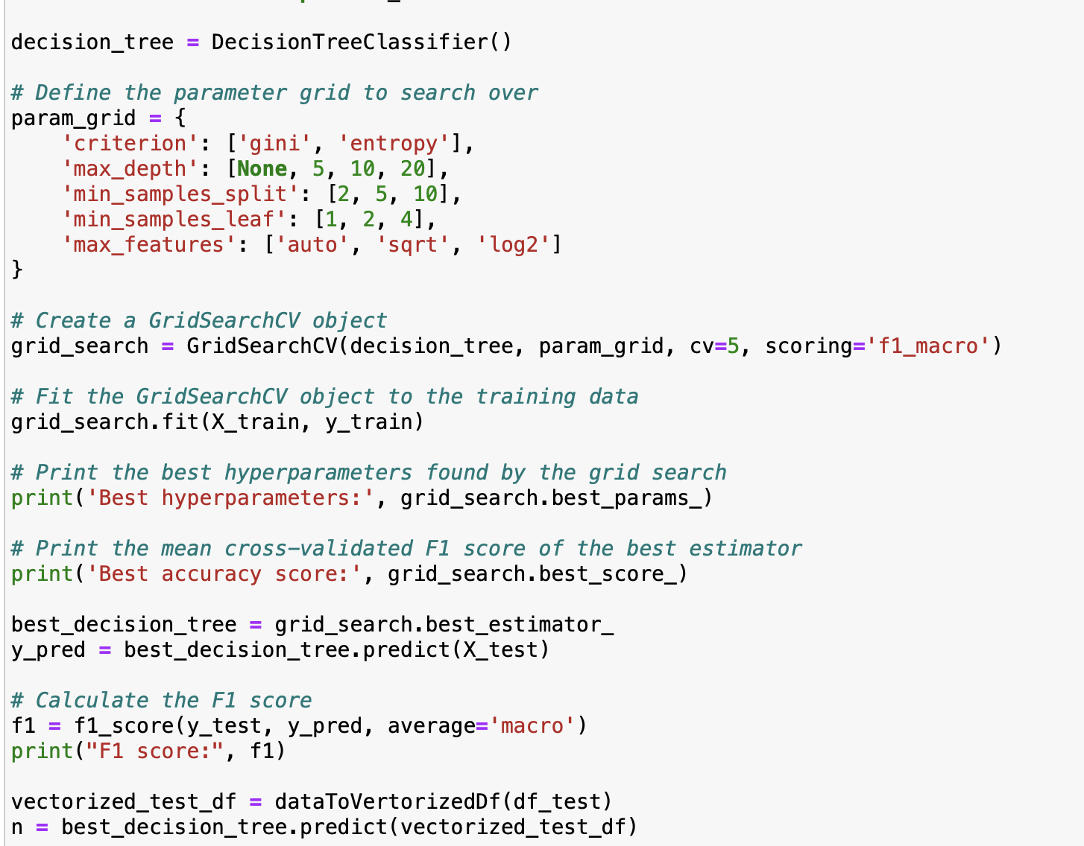
Decision Tree Model

Slide 11
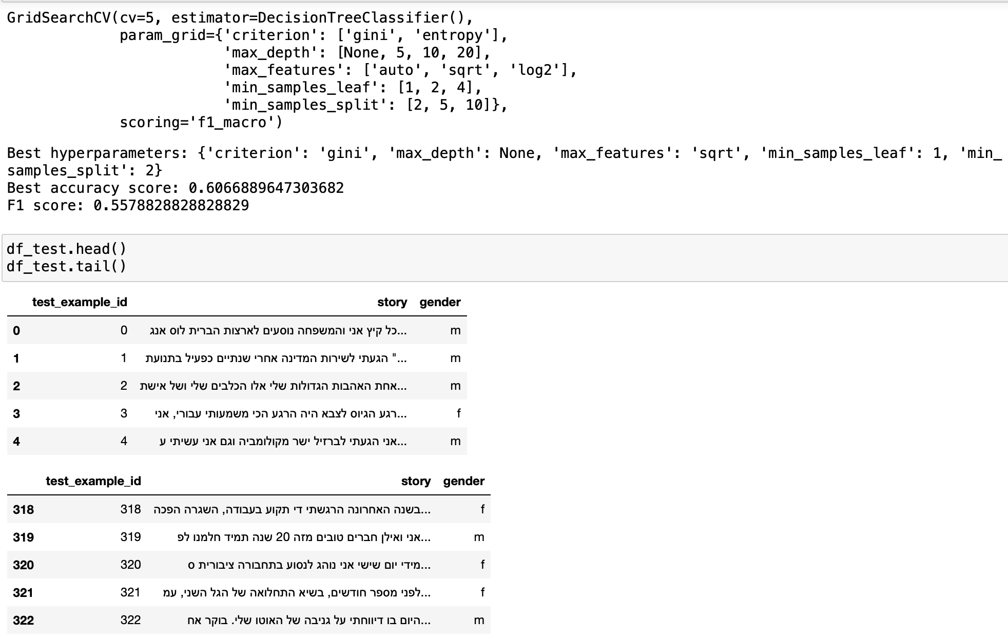
Results Decision Tree

Slide 12




Omer Peled
050-8334100
opeled6@gmail.com

